Slide 1



CAPS
On-campus + tele-health therapy and psychiatry
SOS
Help navigating life’s challenges + finding resources
Timelycare
24/7 tele-health for mental health support with diverse providers
Life’s challenges are easier with support.
Connect today.
univ.lv/sos

Slide 2

CAPS
On-campus + tele-health therapy and psychiatry
SOS
Help navigating life’s challenges + finding resources
Timelycare
24/7 tele-health for mental health support with diverse providers
Support is for everyone.
Connect with us today.
univ.lv/sos

Slide 3

CAPS
On-campus + tele-health therapy and psychiatry
SOS
Help navigating life’s challenges + finding resources
Timelycare
24/7 tele-health for mental health support with diverse providers
It’s never too early- or too late -to prioritize your mental health. Reach out today.
univ.lv/sos

Slide 4

CAPS
On-campus + tele-health therapy and psychiatry
SOS
Help navigating life’s challenges + finding resources
Timelycare
24/7 tele-health for mental health support with diverse providers
Small steps lead to big changes.
Reach out today.
univ.lv/sos

Slide 5

CAPS
On-campus + tele-health therapy and psychiatry
SOS
Help navigating life’s challenges + finding resources
Timelycare
24/7 tele-health for mental health support with diverse providers
Your mental health is worth investing in. Let us help.
univ.lv/sos

Slide 6

CAPS
On-campus + tele-health therapy and psychiatry
SOS
Help navigating life’s challenges + finding resources
Timelycare
24/7 tele-health for mental health support with diverse providers
Don’t wait for stress to take over-
talk to someone today.
univ.lv/sos

Slide 7
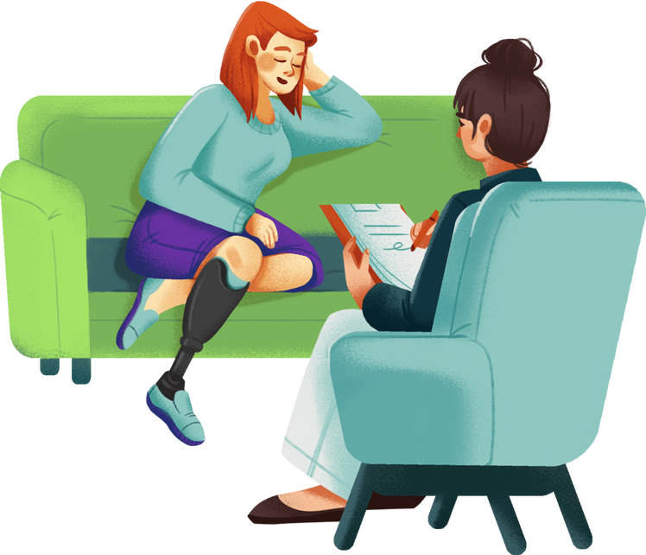
CAPS
On-campus + tele-health therapy and psychiatry
SOS
Help navigating life’s challenges + finding resources
Timelycare
24/7 tele-health for mental health support with diverse providers
You deserve to feel your best.
Let’s work on that together.
univ.lv/sos

Slide 8

CAPS
On-campus + tele-health therapy and psychiatry
SOS
Help navigating life’s challenges + finding resources
Timelycare
24/7 tele-health for mental health support with diverse providers
Reaching out is the first step to feeling better. Connect today.
univ.lv/sos

Slide 9

CAPS
On-campus + tele-health therapy and psychiatry
SOS
Help navigating life’s challenges + finding resources
Timelycare
24/7 tele-health for mental health support with diverse providers
Support is closer than you think.
Let’s connect.
univ.lv/sos

