Slide 1



CAPS
On-campus + tele-health therapy and psychiatry during regular business hours
SOS
Help navigating life’s challenges + finding resources for support
Timelycare
Tele-health for mental health support with diverse providers, this includes scheduled counseling sessions 7 days a week and 24/7 crisis support
Life’s challenges are easier with support.
Connect today.
univ.lv/sos sos@laverne.edu

Slide 2

CAPS
On-campus + tele-health therapy and psychiatry during regular business hours
SOS
Help navigating life’s challenges + finding resources for support
Timelycare
Tele-health for mental health support with diverse providers, this includes scheduled counseling sessions 7 days a week and 24/7 crisis support
Support is for everyone.
Connect with us today.
univ.lv/sos sos@laverne.edu

Slide 3

CAPS
On-campus + tele-health therapy and psychiatry during regular business hours
SOS
Help navigating life’s challenges + finding resources for support
Timelycare
Tele-health for mental health support with diverse providers, this includes scheduled counseling sessions 7 days a week and 24/7 crisis support
It’s never too early- or too late -to prioritize your mental health. Reach out today.
univ.lv/sos sos@laverne.edu

Slide 4

CAPS
On-campus + tele-health therapy and psychiatry during regular business hours
SOS
Help navigating life’s challenges + finding resources for support
Timelycare
Tele-health for mental health support with diverse providers, this includes scheduled counseling sessions 7 days a week and 24/7 crisis support
Small steps lead to big changes.
Reach out today.
univ.lv/sos sos@laverne.edu

Slide 5

CAPS
On-campus + tele-health therapy and psychiatry during regular business hours
SOS
Help navigating life’s challenges + finding resources for support
Timelycare
Tele-health for mental health support with diverse providers, this includes scheduled counseling sessions 7 days a week and 24/7 crisis support
Your mental health is worth investing in. Let us help.
univ.lv/sos sos@laverne.edu

Slide 6

CAPS
On-campus + tele-health therapy and psychiatry during regular business hours
SOS
Help navigating life’s challenges + finding resources for support
Timelycare
Tele-health for mental health support with diverse providers, this includes scheduled counseling sessions 7 days a week and 24/7 crisis support
Don’t wait for stress to take over-
talk to someone today.
univ.lv/sos sos@laverne.edu

Slide 7
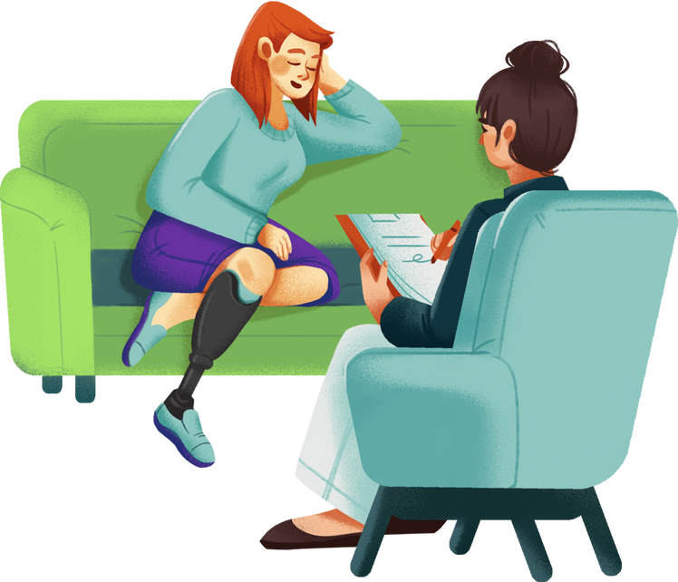
CAPS
On-campus + tele-health therapy and psychiatry during regular business hours
SOS
Help navigating life’s challenges + finding resources for support
Timelycare
Tele-health for mental health support with diverse providers, this includes scheduled counseling sessions 7 days a week and 24/7 crisis support
You deserve to feel your best.
Let’s work on that together.
univ.lv/sos sos@laverne.edu

Slide 8

CAPS
On-campus + tele-health therapy and psychiatry during regular business hours
SOS
Help navigating life’s challenges + finding resources for support
Timelycare
Tele-health for mental health support with diverse providers, this includes scheduled counseling sessions 7 days a week and 24/7 crisis support
Reaching out is the first step to feeling better. Connect today.
univ.lv/sos sos@laverne.edu

Slide 9

CAPS
On-campus + tele-health therapy and psychiatry during regular business hours
SOS
Help navigating life’s challenges + finding resources for support
Timelycare
Tele-health for mental health support with diverse providers, this includes scheduled counseling sessions 7 days a week and 24/7 crisis support
Support is closer than you think.
Let’s connect.
univ.lv/sos sos@laverne.edu

